Slide 1
Lab #8
Traffic Light Controller
Simulation results, no hardware implementation

Slide 2
The control specifications
After pushing the pushbutton, turn on the yellow light for cars (4 seconds)
Give NOWALK sign to the pedestrian
Turn on the red light for cars (20 seconds)
Give WALK sign to the pedestrian (16 seconds)
Flash WALK sign to the pedestrian (4 seconds)
Turn the green light for cars (32 seconds)
Give NOWALK sign for the pedestrian
The green light for cars stays on for 32 seconds or until pushing the button after 32 seconds.
Simulation results, no hardware implementation

Slide 3
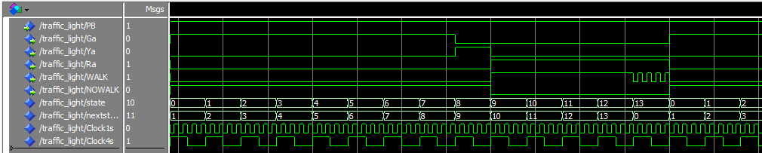
Timing & State Diagram
S0
S1
S2
S3
S4
S5
S6
S7
Ga, NW
Ga, NW
Ga, NW
Ga, NW
Ga, NW
Ga, NW
Ga, NW
Ga, NW
PB
PB
S13
S12
S11
S10
S9
S8
Ra, FW
Ra, W
Ra, W
Ra, W
Ra, W
Ya, NW

Slide 4
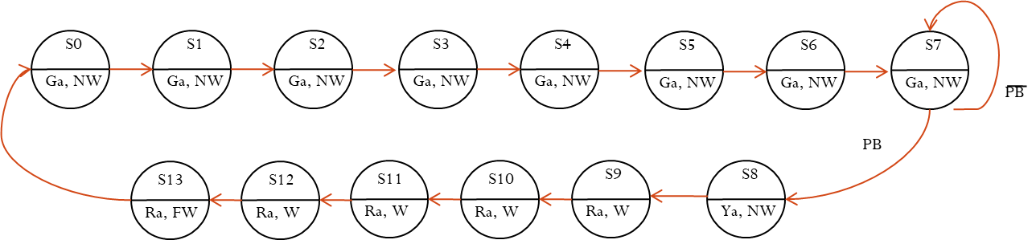
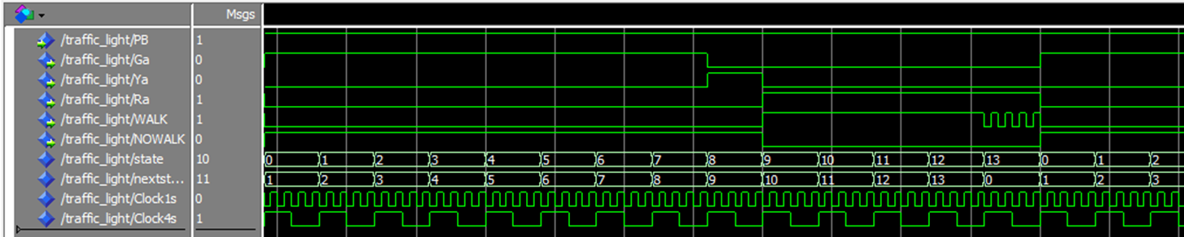
What should you do?
Read section 4.4 (Traffic light controller) in your book.
Download and uncompressed files from canvas.
Add all files to the modelsim and then:
You need to write one more code (traffic light. VHD).
After writing the code that represent the traffic light state diagram.
You should get the following time diagram of the previous page. Getting the flashing WALK is optional I will not take any point if you don’t include this step.

Slide 5
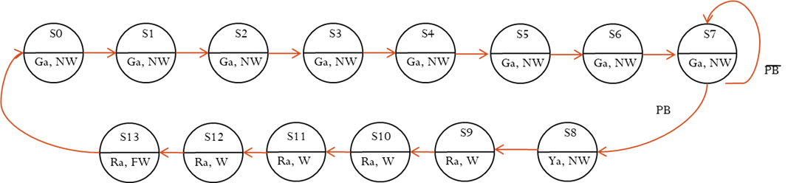
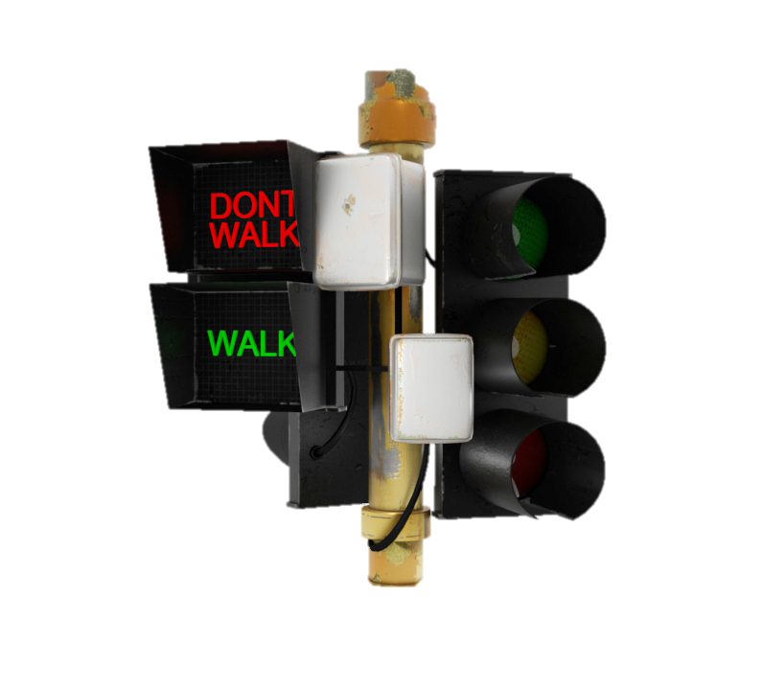
More Explanation
 | 0 | 4 | 8 | 12 | 16 | 20 | 24 | 28 | 32 | 36 | 40 | 44 | 48 | 52 | 56
G
Y
R
NW
W
Street
Number of steps=the total time of the period/ state length =56/4 =14
EBW
EBE
Flashing Walk
Last 4 seconds

Slide 6
Hints
Use the following library and part of the code then follow the rest of the notes.
You need to create two signal (state , next state as an integer to count all the 14 states we have.
You need to create two signals (clk1 to generate 1second period , clk4 to generate 4 second period). Both are std_logic.
You will need to use the Genclock given to you as a component.(Use the GenClock.VHD I attached)
Your need two processor code with the first processor sensitive list is (clk4, clk1). Second one has sensitive list as (clk4).
You have counter inside your first process to increase the state by one and put it’s value in next state:
nextstate <= state +1 ;
First processor include all the case states and second processor used to equate the state value to next state.
Use the example given to you in the book as a guide to help you understand how to write the case states.
To port map your traffic light use the following generic map in your code
Clock1s : GenClock generic map ( 1 ) port map (clk, clk1);
Clock4s : GenClock generic map ( 3 ) port map (clk, clk4);
LIBRARY IEEE ;
USE IEEE.STD_LOGIC_1164.all ;
USE IEEE.STD_LOGIC_ARITH.all ;
USE IEEE.STD_LOGIC_UNSIGNED.all ;
ENTITY traffic_light is
PORT (clk, PB : in std_logic ;
Ga,Ya,Ra,WALK,NOWALK : inout std_logic );
END traffic_light ;
Architecture traffLight of traffic_light is
signal state, nextstate : integer range 0 to 13 ;
signal clk1 : std_logic := '0' ;
signal clk4 : std_logic := '0' ;
component GenClock
generic (time_period : integer range 1 to 4 );
port (clk : in std_logic ;
Clock : inout std_logic );
end component ;
begin;

Slide 7
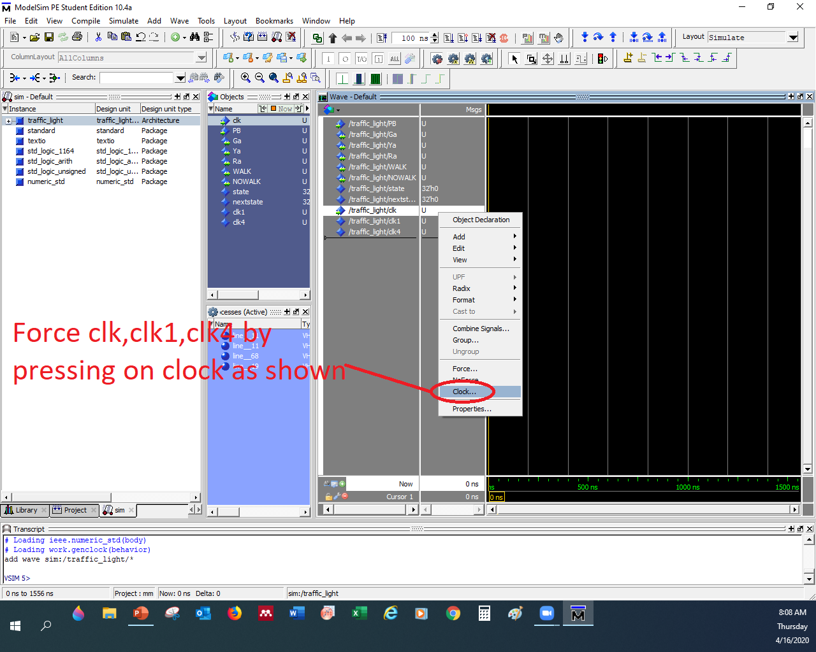
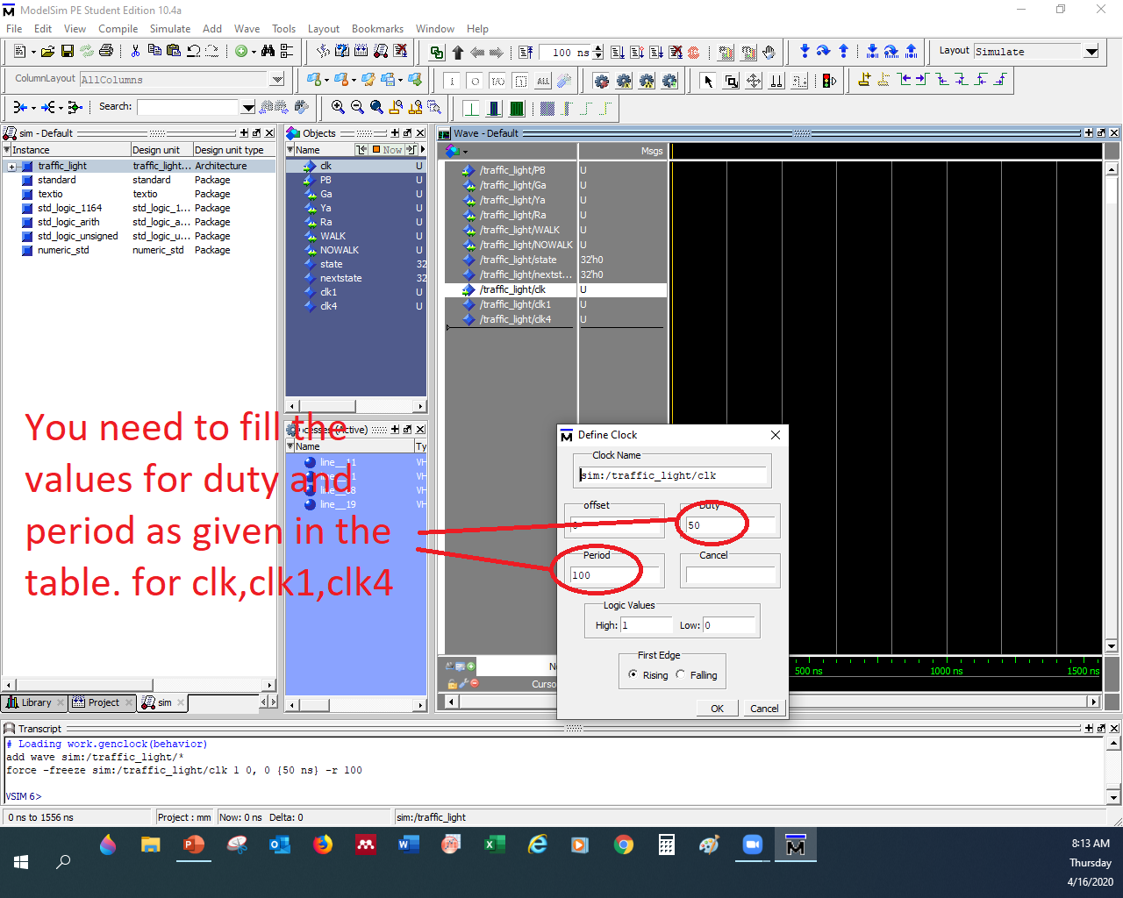
Extra notes to run your simulation
Your main entity is the Traffic light file you wrote it
You can start by forcing Pb=1 and force the following clock values(see attached pictures), then run the code many times to get the results.
 | Duty | period
Clk | 50 | 200
Clk1 | 50 | 400
Clk4 | 50 | 800

Slide 8
Report Delivery
Answer all procedure questions.
Include simulation results.
Include your written code (traffic light ) and all given codes.
Include state diagram.
Include a good explanation about the experiment (explain your code).

